Slide 1
Covid-19 Contact Tracing Application
Neil Byrne
G00343624
Supervisor:
Mr. Gerard Harrison

Slide 2
Project Features
A mobile app containing the user’s contact details
RFID scan transfers information to RFID receiver
Geo-tag for user to easily identify when where they have been
Easy contact tracing for user and receiver
MEAN stack and IoT development
Why?
Breach of GDPR
Long-term solution
Learn more about IoT devices and MEAN stack

Slide 3
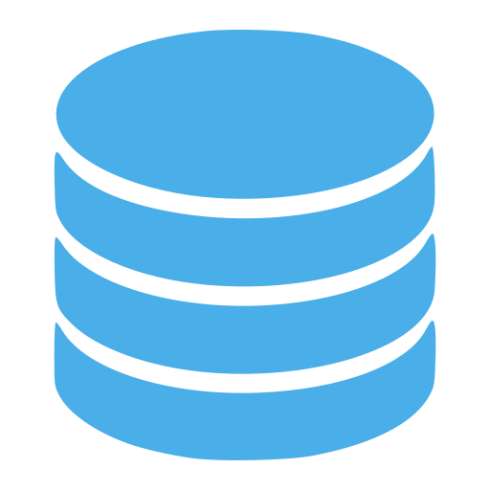
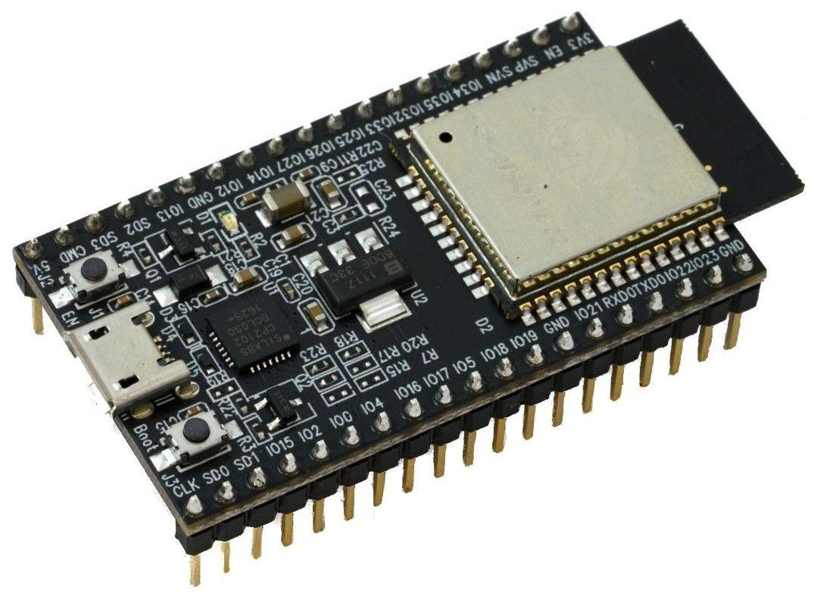
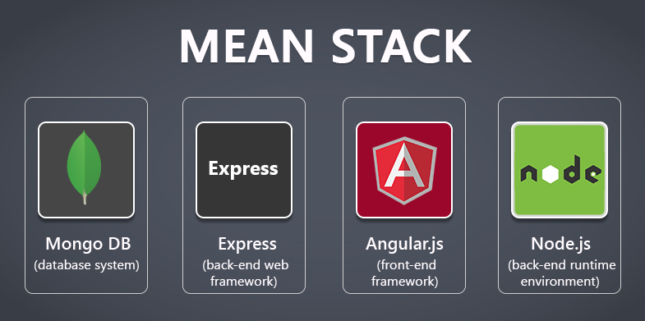
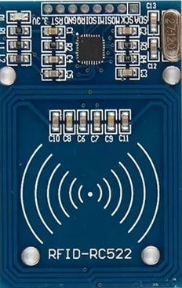


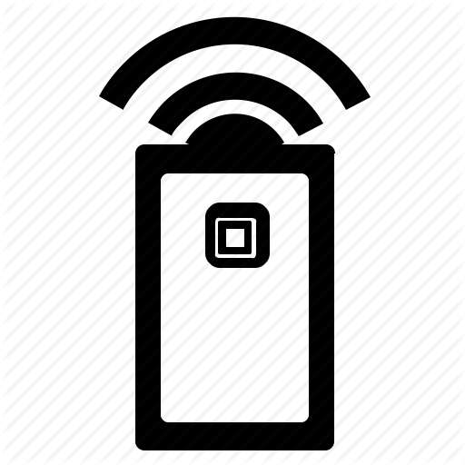

Architecture
Web App
NodeMCU 32 Board
Mongo DB
RFID Reader
Admin
Mobile App

Slide 4
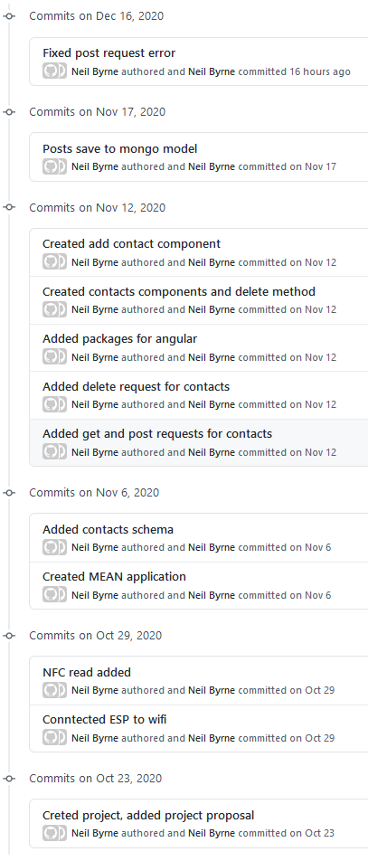
Development & Deployment
ESP32 RFID wired and functional
Basic CRUD application created

Slide 5
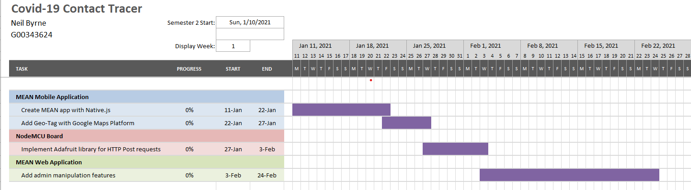
Work Plan

Slide 6
Thank You

